Slide 1

Logic Languages
Sabrina Tarin Chowdhury

Slide 2
Languages
Paradigms of Programming Languages:
Imperative = Turing machines
Functional Programming = lambda calculus
Logical Programming = first-order predicate calculus
Prolog and its variants make up the most commonly used Logical programming languages.
Variants : XSB Prolog, SWI Prolog, Sicstus,Yap Prolog, Ciao Prolog, GNU Prolog, etc.

Slide 3
Relations/Predicates
Predicates are building-blocks in predicate calculus: p(a₁,a₂,...,a_{k})
parent(X, Y): X is a parent of Y.
parent(pam, | bob). | parent(bob, | ann).
parent(tom, | bob). | parent(bob, | pat).
parent(tom, | liz). | parent(pat, | jim).
male(X): X is a male. male(tom). male(bob). male(jim).
female(X): X is a female. female(pam). female(pat). female(ann). female(liz).

Slide 4
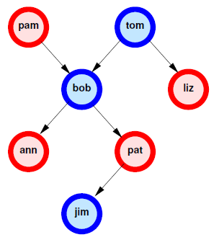
Relations
parent(pam, bob). parent(tom, bob). parent(tom, liz). parent(bob, ann). parent(bob, pat). parent(pat, jim). female(pam). female(pat). female(ann). female(liz). male(tom). male(bob).
5
male(jim).

Slide 5
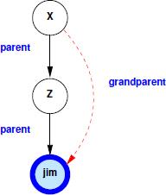
Relations
Rules:
mother(X, Y): X is the mother of Y.
-In First Order Logic (FOL or predicate calculus):
∀X,Y (parent(X,Y) ∧ female(X) => mother(X,Y))
-In Prolog:
mother(X,Y) :-
parent(X,Y), female(X).
all variables are universally quantified outside the rule
“,” means and (conjunction), “:-” means if
(implication) and “;” means or (disjunction).
More Relations:
grandparent(X,Y) :- parent(X,Z),
parent(Z,Y).
6

Slide 6
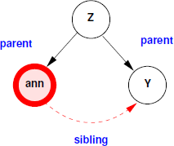
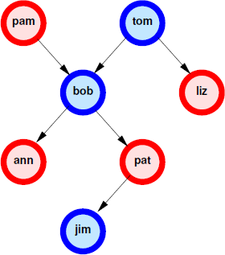
Relations
mother(X,Y):-
parent(X,Y),female(X).
sibling(X,Y) :- parent(Z,X), parent(Z,Y), X \= Y.
?- sibling(ann,Y).
?- mother(M, bob).
?- parent(M, bob), female(M).
?- M=pam, female(pam). M = pam true
?- father(M, bob).
?- parent(M, bob), male(M)
?- M=pam, male(pam). fail
?- M=tom, male(tom).
Call: Call a predicate (invocation)
Exit: Return an answer to the caller
Fail: Return to caller with no answer
Redo:Try next path to find an answer
M = tom true

Slide 7
The XSB Prolog System
Put your ruleset and data in a file with extension .P (or .pl)
p(X) :- q(X,_). q(1,a).
q(2,a).
q(b,c).
Don’t forget: all rules and facts end with a period (.)
Comments: /*…*/ or %.... (% acts like // in Java/C++)
Type
…/XSB/bin/xsb (Linux/Cygwin)
…\XSB\config\x86-pc-windows\bin\xsb (Windows)
where … is the path to the directory where you downloaded XSB
You will see a prompt
| ?-
and are now ready to type queries
http://xsb.sourceforge.net
Overview of Installation:
Unzip/untar; this will create a subdirectory XSB
Windows: you are done
Linux:
cd XSB/build
./configure
./makexsb
That’s it!
Cygwin under Windows: same as in Linux
Online Compiler : https://swish.swi-prolog.org/

Slide 8
Use of XSB
Some Useful Tricks:
XSB returns only the first answer to the query
To get the next, type ; <Return>. For instance:
| ?- q(X). X = 2;
X = 4
yes
Usually, typing the ;’s is tedious. To do this programmatically,
use this idiom:
| ?- (q(_X), write('X='), writeln(_X), fail ; true).
_X here tells XSB to not print its own answers,
since we are printing them by ourselves.
XSB won’t print answers for variables that are prefixed with a _.
Loading your program, myprog.P or myprog.pl
?- [myprog].
XSB will compile myprog.P (if necessary) and load it. Now you can type further queries, e.g.
?- p(X).
?- p(1).
Some Useful Built-ins:
write(X) – write whatever X is bound to
writeln(X) – write then put newline
nl – output newline
Equality: =
Inequality: \=
http://xsb.sourceforge.net/manual1/index.html (Volume 1)
http://xsb.sourceforge.net/manual2/index.html (Volume 2)

Slide 9
Syntax of Prolog Programs
A Prolog program is a sequence of clauses
Each clause (sometimes called a rule or Horn rule) is of the form:
Head :- Body.
Head is one term
Body is a comma-separated list of terms
A clause with an empty body is called a fact
A term can be a constant, variable, or structure (consisting of a functor and a parenthesized list of arguments)
A constant is either an atom or a number
An atom is either what looks like an identifier beginning with a lowercase letter, or a single quoted string
A number looks like an integer or real from some more ordinary language
A variable looks like an identifier beginning with an upper-case letter
There are NO declarations (vars, terms, or predicates)
All types are discovered implicitly

Slide 10
Logic Programming Concepts
The Prolog interpreter has a collection of facts and rules in its DATABASE
Facts (i.e., clauses with empty bodies):
raining(ny). raining(seattle).
Facts are axioms (things the interpreter assumes to be true)
Prolog provides an automatic way to deduce true results from facts and rules
A rule (i.e., a clause with both sides):
wet(X) :- raining(X).
The meaning of a rule is that the conjunction of the structures in the body implies the head.
Note: Single-assignment variables: X must have the same value on both sides.
Query or goal (i.e., a clause with an empty head):
?- wet(X).

Slide 11
Logic Programming Concepts
The scope of a variable is the clause in which it appears:
Variables whose first appearance is on the left hand side of the clause (i.e., the head) have implicit universal quantifiers
For example, we infer for all possible X that they are employed employed(X) :- employs(Y,X).
Variables whose first appearance is in the body of the clause have implicit existential quantifiers in that body
For example, there exists some Y that employs X
Note that these variables are also universally quantified outside the rule (by logical equivalences)

Slide 12
Logic Programming Concepts
grandmother(A, C) :- mother(A, B),
mother(B, C).
can be read as:
"for all A, C [A is the grandmother of C if there exists a B such that A is the mother of B and B is the mother of C]"
We probably want another rule that says:
grandmother(A, C) :- mother(A, B),
father(B, C).

Slide 13
Recursion
Transitive closure:
Example: a graph declared with facts (true statements)
edge(1,2).
edge(2,3).
edge(2,4).
if there's an edge from X to Y, we can reach Y from X: reach(X,Y) :- edge(X,Y).
if there's an edge from X to Z, and we can reach Y from
Z, then we can reach Y from X: reach(X,Y) :-
edge(X,Z),
reach(Z, Y).

Slide 14
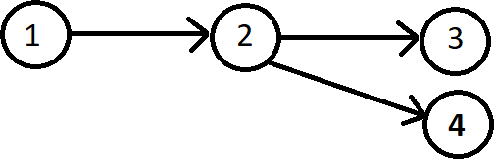
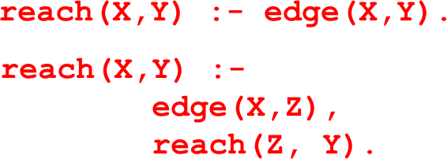
?- reach(X,Y).
X = 1
Y = 2; ← Type a semi-colon repeatedly for
X = 2 more answers
Y = 3;
X = 2
Y = 4;
X = 1
Y = 3;
X = 1
Y = 4;
no
28

Slide 15
Prolog Programs
We will now explore Prolog programs in more detail:
Syntax of Prolog Programs
Terms can be:
Atomic data
Variables
Structures

Slide 16
Atomic Data
Numeric constants: integers, floating point numbers (e.g. 1024, -42, 3.1415, 6.023e23,…)
Atoms:
Identifiers: sequence of letters, digits, underscore, beginning with a lower case letter (e.g. paul, r2d2, one_element).
Strings of characters enclosed in single quotes (e.g. 'Stony Brook')

Slide 17
Variables
Variables are denoted by identifiers beginning with an
Uppercase letter or underscore (e.g. X, Index, _param).
These are Single-Assignment Logical variables:
Variables can be assigned only once
Different occurrences of the same variable in a clause denote the same data
Variables are implicitly declared upon first use
Variables are not typed
All types are discovered implicitly (no declarations in LP)
If the variable does not start with underscore, it is assumed that it appears multiple times in the rule.
If is does not appear multiple times, then a warning is produced: "Singleton variable"
⚫ You can use variables preceded with underscore to eliminate this warning

Slide 18
Variables
Anonymous variables (also called Don’t care variables): variables beginning with "_"
Underscore, by itself (i.e., _), represents a variable
Each occurrence of _ corresponds to a different variable; even within a clause, _ does not stand for one and the same object.
A variable with a name beginning with "_", but has more characters. E.g.: _radius, _Size
we want to give it a descriptive name
sometimes it is used to create relationships within a clause (and must therefore be used more than once): a warning is produced: "Singleton-marked variable appears more than once"

Slide 19
Variables
Variables can be assigned only once, but that value can be further refined:
?- X=f(Y),
Y=g(Z), Z=2.
Therefore, X=f(g(2)), Y=g(2), Z=2
The order also does not matter:
?- Z=2,
X=f(Y),
Y=g(Z).
X = f(g(2)), Y=g(2), Z=2
Even infinite structures:
?- X=f(X).
X=f(f(f(f(f(f(f(f(f(f(...))
Warnings are used to identify bugs (most because of copy-paste errors)
Instead of declarations and type checking
Fix all the warnings in a program, so you know that you don't miss any logical error

Slide 20
Meaning of Logic Programs
Declarative Meaning: What are the logical consequences of a program?
Procedural Meaning: For what values of the variables in the query can I prove the query?
The user gives the system a goal:
The system attempts to find axioms + inference rules to prove that goal
If goal contains variables, then also gives the values for those variables for which the goal
is proven
36

Slide 21
Declarative Meaning
brown(bear). gray(elephant). black(cat).
big(bear). big(elephant). small(cat).
A query is, in general, a conjunction of goals: G₁,G₂,…,G_{n}
To prove G₁,G₂,…,G_{n}:
Find a clause H :- B₁,B₂, …, B_{k} such that G₁ and H match.
Under the substitution for variables, prove B₁,B₂,…,B_{k},G₂,…,G_{n}
If nothing is left to prove then the proof succeeds!
If there are no more clauses to match, the proof fails!
dark(Z) :- black(Z).
dark(Z) :- brown(Z). dangerous(X) :- dark(X), big(X).
The logical consequences of a program L is the smallest set such that
All facts of the program are in L,
If H :- B₁,B₂, …, B_{n} . is an instance of a clause in the program such that B₁,B₂, …, B_{n} are all in L, then H is also in L.
For the above program we get dark(cat) and dark(bear) and consequently dangerous(bear) in addition to the original facts.

Slide 22
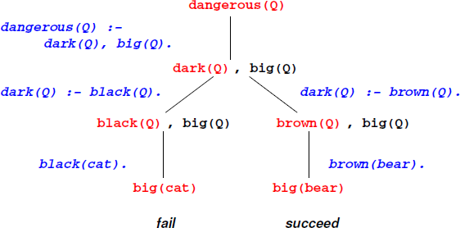
Procedural Meaning of Prolog
To prove: ?- dangerous(Q).
Select dangerous(X):-dark(X),big(X) and prove
dark(Q),big(Q).
To prove dark(Q) select the first clause of dark, i.e.
dark(Z):-black(Z), and prove black(Q),big(Q).
brown(bear). gray(elephant). black(cat).
big(bear). big(elephant). small(cat).
dark(Z) :- black(Z).
dark(Z) :- brown(Z). dangerous(X) :- dark(X), big(X).
3. Now select the fact black(cat) and prove big(cat).
fails!
4. Go back to step 2, and select the second clause of dark, i.e.
dark(Z):-brown(Z), and prove brown(Q),big(Q).
Now select brown(bear) and prove big(bear).
Select the fact big(bear).
There is nothing left to prove, so the proof succeeds
The Prolog interpreter works by what is called BACKWARD CHAINING (also called top-down, goal directed)

Slide 23
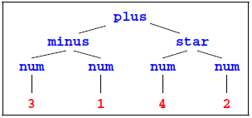
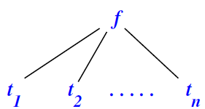
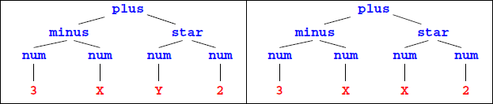
Structures
If f is an identifier and t₁, t₂, …, t_{n} are terms, then f(t₁, t₂, …, t_{n}) is a term
Example: expression trees:
plus(minus(num(3),num(1)),star(num(4),num(2)))
Data structures may have variables AND the same variable may occur multiple times in a data structure
( )
In the above, f is called a functor and t_{i}s are called arguments
Structures are used to group related data items together (in some ways similar to struct in C and objects in Java)
Structures are used to construct trees (and, as a special case of trees, lists)
48

Slide 24
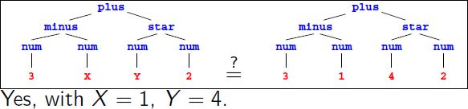
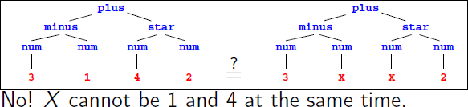
Matching
Which of these match?
A
100
func(B)
func(100)
func(C, D)
func(+(99, 1))
A matches with 100, func(B), func(100), func(C,D), func(+(99, 1)).
100 matches only with A.
func(B) matches with A, func(100), func(+(99, 1))
func(C, D) matches with A.
func(+(99, 1)) matches with A and func(B).
t1 = t2: finds substitutions for variables in t1 and t2 that make the two terms identical
(We'll later introduce unification, a related operation that has logical semantics)

Slide 25
Accessing arguments of a structure
Matching is the predominant means for accessing structures arguments
Let date('Sep', 1, 2020) be a structure used to represent dates, with the month, day and year as the three arguments (in that order!)
then makes
M = 'Sep',
date(M,D,Y) = date('Sep',1,2020).
D = 1, Y = 2020
If we want to get only the day, we can write
date(_, D, _) = date('Sep', 1, 2020).
Then we only get: D = 1

Slide 26
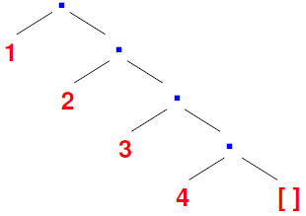
Lists
Prolog uses a special syntax to represent and manipulate lists:
[1,2,3,4]: represents the list with 1, 2, 3 and 4, respectively.
This can also be written as [1|[2,3,4]]: a list with 1 as the head (i.e., first element) and [2,3,4] as its tail (i.e., the list of remaining elements).
If X = 1 and Y = [2,3,4] then [X|Y] is same as [1,2,3,4].
The empty list is represented by [] or nil
The symbol "|" (pipe) and is used to separate the beginning elements of a list from its tail
For example: [1,2|[3,4]] = [1,2,3|[4]] =
[1,2,3,4] = [1,2,3,4|[]] = [1|[2,3,4]] =
[1|[2|[3,4]]] = [1|[2|[3|[4|[]]]]]
Lists are special cases of trees
For instance, the list [1,2,3,4] is represented by the following structure:

Slide 27
Programming with Lists
member/2 finds if a given element occurs in a list:
The program:
member(X, [X|_]).
member(X, [_|Ys]) :-
member(X,Ys).
Example queries:
?- member(2,[1,2,3]).
?- member(X,[l,i,s,t]).
?- member(f(X),[f(1),g(2),f(3),h(4)]).
?- member(1,L).

Slide 28
Programming with Lists
append/3 concatenate two lists to form the third list:
The program:
Empty list append L is L:
append([], L, L).
Otherwise, break the first list up into the head X, and the tail L: if L append M is N, then [X|L] append M is [X|N]:
append([X|L], M, [X|N]) :-
append(L, M, N).
Example queries:
?- append([1,2],[3,4],X).
?- append(X, Y, [1,2,3,4]).
?- append(X, [3,4], [1,2,3,4]).
?- append([1,2], Y, [1,2,3,4]).

Slide 29
Append example trace
append([],L,L).
append([X|L], M, [X|N]) :- append(L,M,N).
append([1,2],[3,4],X)?
append([],L,L).
append([X|L],M,[X|N]) :- append(L,M,N).
append([1,2],[3,4],A)?
X=1,L=[2],M=[3,4],A=[X|N]

Slide 30
Append example trace
append([],L,L).
append([X|L],M,[X|N’]) :- append(L,M,N’).
append([2],[3,4],N)?
X=2,L=[],M=[3,4],N=[2|N’]
append([1,2],[3,4],A)?
X=1,L=[2],M=[3,4],A=[1|N]

Slide 31
Append example trace
append([],L,L).
append([X|L],M,[X|N’]) :- append(L,M,N’).
append([],[3,4],N’)?
append([2],[3,4],N)? | X=2,L=[],M=[3,4],N=[2|N’]
append([1,2],[3,4],A)? | X=1,L=[2],M=[3,4],A=[1|N]

Slide 32
Append example trace
append([],L,L).
append([X|L],M,[X|N’]) :- append(L,M,N’).
append([],[3,4],N’)? | L = [3,4], N’ = L
append([2],[3,4],N)? | X=2,L=[],M=[3,4],N=[2|N’]
append([1,2],[3,4],A)? | X=1,L=[2],M=[3,4],A=[1|N]

Slide 33
Append example trace
append([],L,L).
append([X|L],M,[X|N’]) :- append(L,M,N’).
A = [1|N]
N = [2|N’] N’= L
L = [3,4]
Answer: A = [1,2,3,4]
append([],[3,4],N’)? | L = [3,4], N’ = L
append([2],[3,4],N)? | X=2,L=[],M=[3,4],N=[2|N’]
append([1,2],[3,4],A)? | X=1,L=[2],M=[3,4],A=[1|N]

Slide 34
Programming with Lists
len/2 to find the length of a list (the first argument):
The program:
len([], 0).
len([_|Xs], N+1) :- len(Xs, N).
Example queries:
?- len([], X).
X = 0
?- len([l,i,s,t], 4). false
?- len([l,i,s,t], X).
X = 0+1+1+1+1

Slide 35
Conditional Evaluation
Conditional operator: the if-then-else construct in Prolog:
if A then B else C is written as ( A -> B ; C)
To Prolog this means: try A. If you can prove it, go on to prove B and ignore C. If A fails, however, go on to
prove C ignoring B.
max(X,Y,Z) :-
( X =< Y
-> ; | Z Z | = = | Y X
).
?- max(1,2,X).
X = 2.

Slide 36
Conditional Evaluation
Consider the computation of n! (i.e. the factorial of n)
% factorial(+N, -F) factorial(N, F) :- ...
N is the input parameter and F is the output parameter!
The body of the rule species how the output is related to the input
For factorial, there are two cases: N <= 0 and N > 0
if N <= 0, then F = 1
if N > 0, then F = N * factorial(N - 1)
factorial(N, F) :- (N > 0
-> N1 is N-1,
factorial(N1, F1),
F is N*F1
; F = 1
?- factorial(12,X).
X = 479001600
76
).

Slide 37
Arithmetic Operators
Integer/Floating Point operators: +, -, *, /
Automatic detection of Integer/Floating Point
Integer operators: mod, // (integer division)
Comparison operators: <, >, =<, >=,
Expr1 =:= Expr2 (succeeds if expression
Expr1 evaluates to a number equal to Expr2), Expr1 =\= Expr2 (succeeds if expression
Expr1 evaluates to a number non-equal to Expr2)

Slide 38
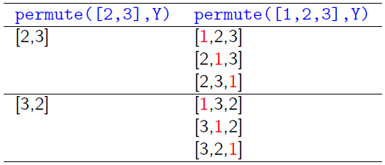
Permutations
Define permute/2, to find a permutation of a given list.
E.g. permute([1,2,3], X) should return X=[1,2,3] and upon backtracking, X=[1,3,2], X=[2,1,3], X=[2,3,1], X=[3,1,2], and X=[3,2,1].
Hint:What is the relationship between the permutations of
[1,2,3] and the permutations of [2,3]?

Slide 39
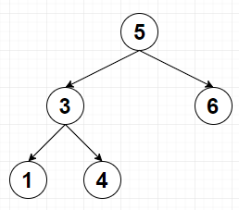
Tree Traversal
Assume you have a binary tree, represented by
node/3 facts for internal nodes: node(a,b,c)
means that a has b and c as children
leaf/1 facts: for leaves: leaf(a) means that a
is a leaf
Example:
node(5, | 3, | 6).
node(3, | 1, | 4).
leaf(1).
leaf(4).
leaf(6).

